Slide 1
Just Talk’s Real Bodies in Herts campaign

Slide 2
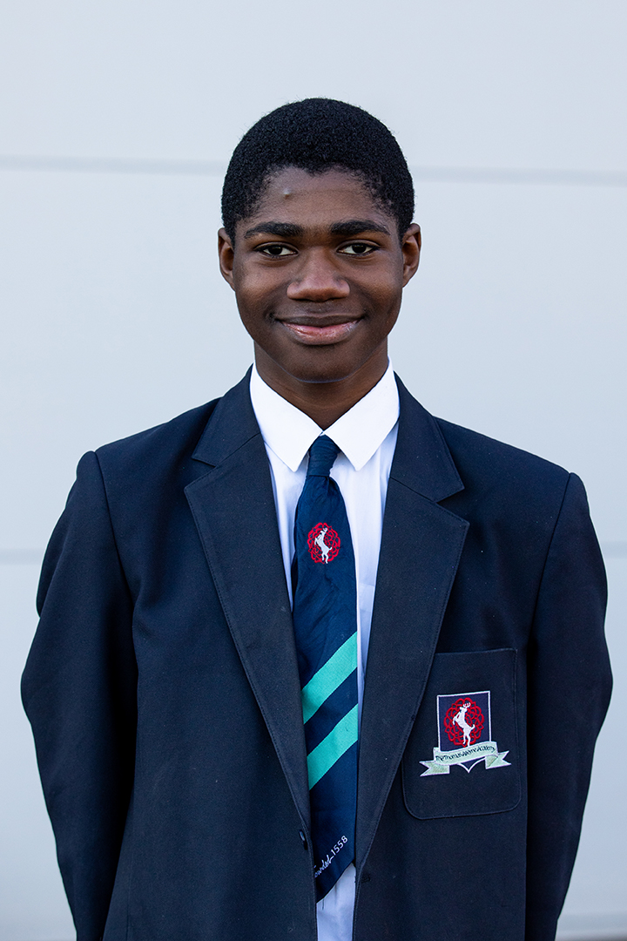
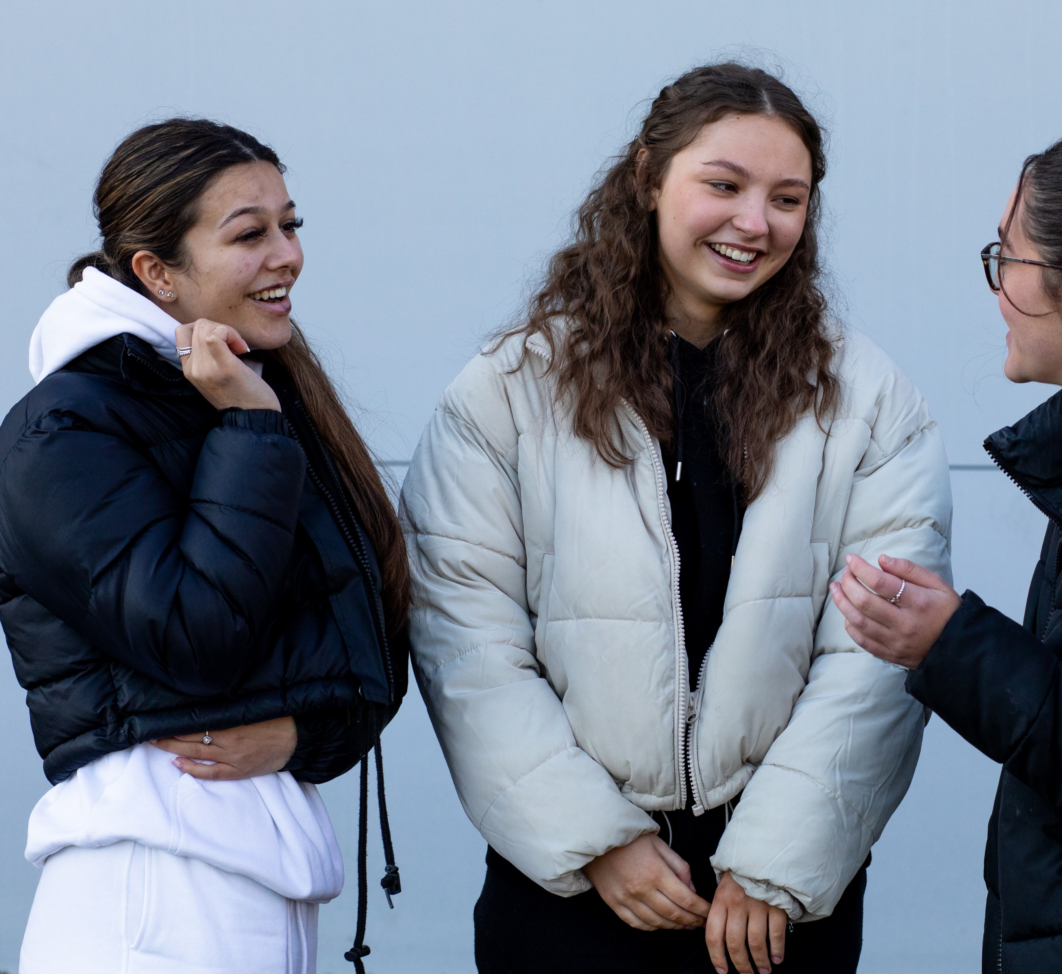
What is Just Talk?
Just Talk is a positive mental health programme, designed with and for Hertfordshire’s 8-24 year olds, with the aim:
“To make Hertfordshire a county in which all young people recognise that it’s ok not to be okay, feel comfortable and confident in talking about mental health, have tools for looking after their wellbeing and know how to access support when it’s needed”.
We offer practical advice on how you can look after your mental health and our website hosts a load of free resources, such as e-learning and journals. Visit www.justtalkherts.org to find out more!

Slide 3
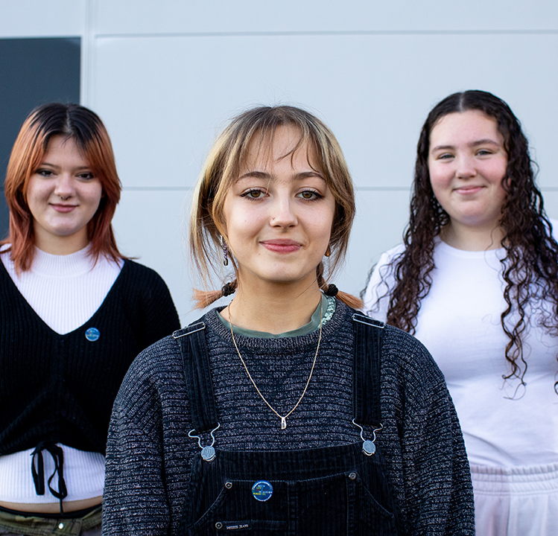
Why body image?
Do you every find yourself worrying about the way you look? You’re not alone.
Almost 1 in 2 Hertfordshire young people worry about their appearance - this is far too high!
Just Talk want to stop this figure from rising, and encourage all Hertfordshire young people to:
Celebrate the fact everyone has a different body
Know they are good enough
Not compare themselves to others
Recognise their positive qualities
So, they are launching the positive body image campaign ‘Real Bodies in Herts’.

Slide 4
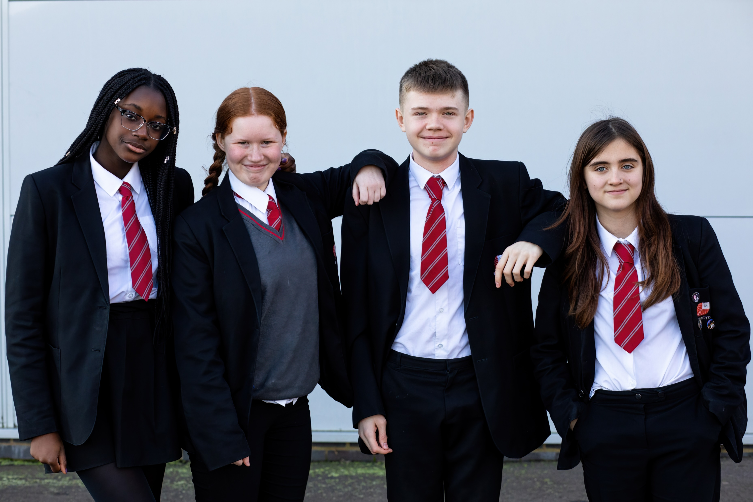
‘Real Bodies in Herts’
This entire campaign, from its name to the positive advice used on posters, was created with real Hertfordshire students - like you.
Throughout the campaign, Just Talk will be sharing:
Helpful advice on how young people can build body image confidence
Uplifting body image affirmations from other Herts’ young people
Useful tools to help you boost your mental health and wellbeing
Information on where to go if you are struggling with your body image

Slide 5
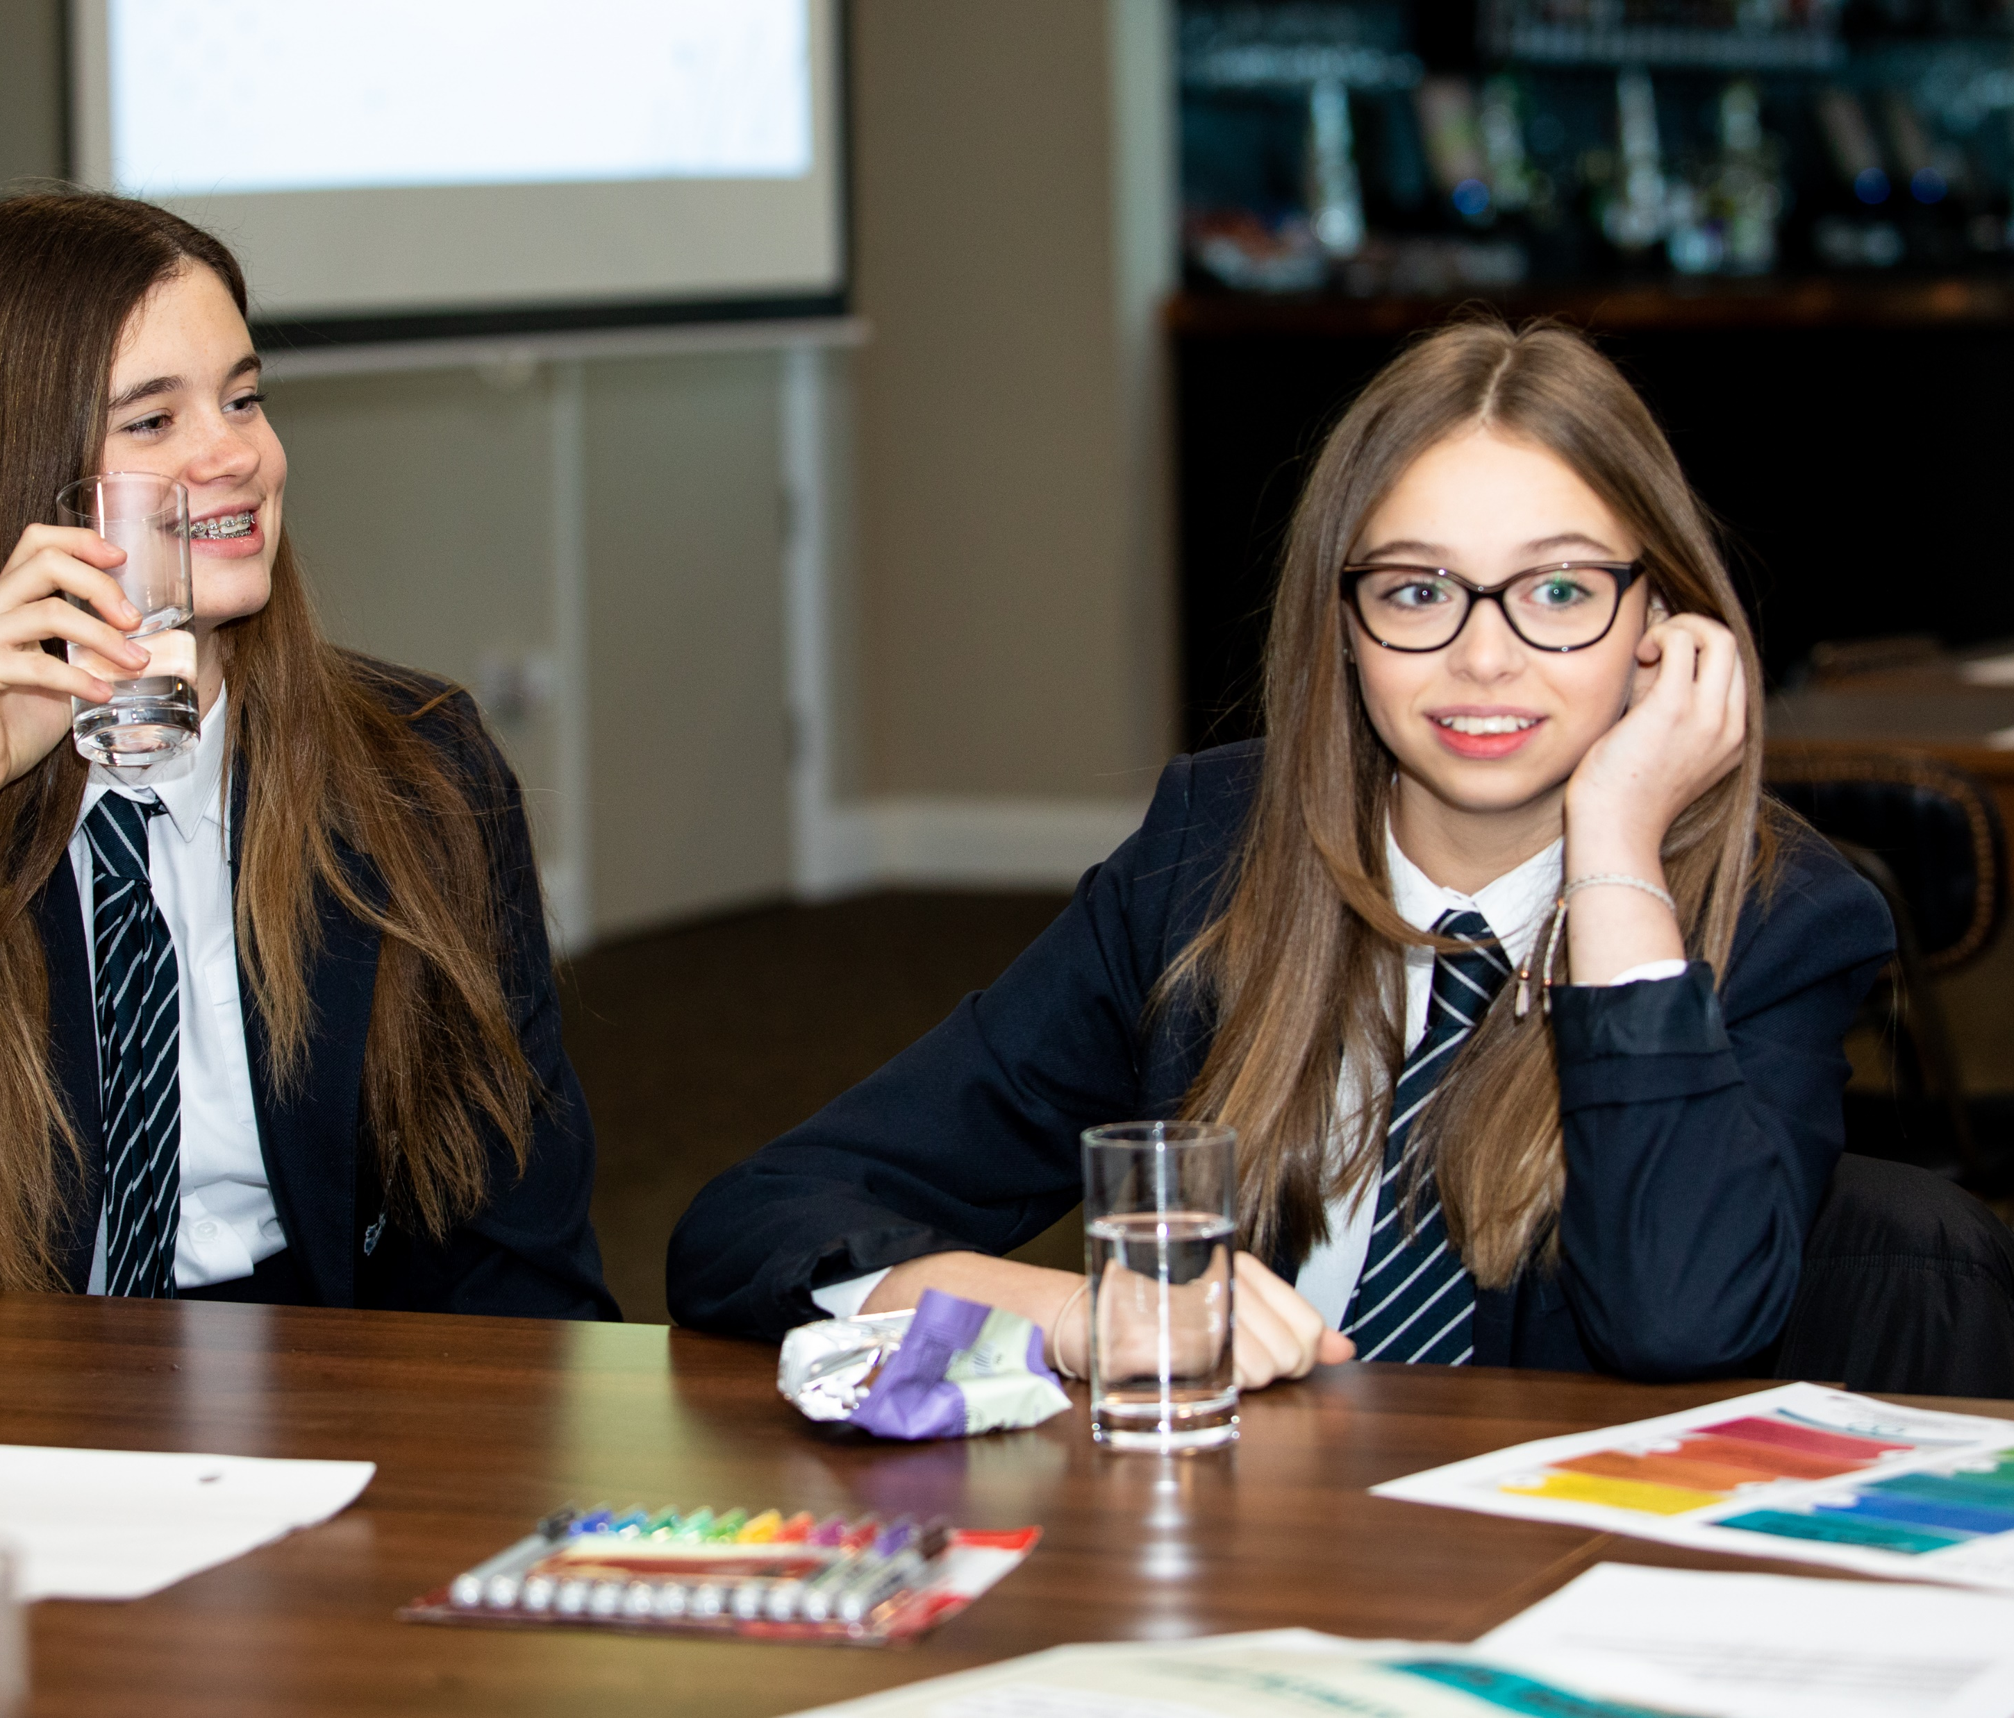
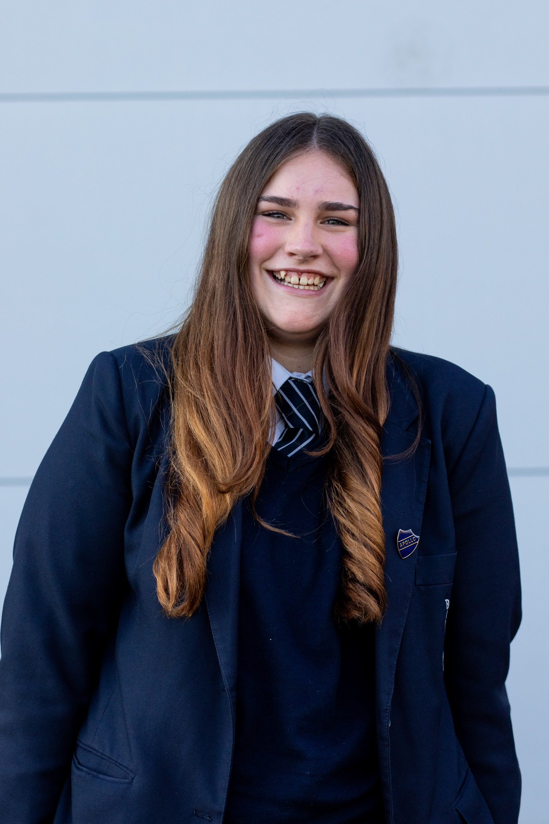
What’s on offer?
Throughout the ‘Real Bodies in Herts’ campaign, Just Talk’s partners are offering:
A free First Steps ED helpline - available to answer any body image questions and offer advice around eating difficulties and eating disorders
A social media ‘top tips’ document – to help you use social media in a way that doesn’t negatively impact your body image or mental health
Self-care document – exploring different therapeutic techniques which can help you with your body image
Body image Q&A session – you can submit your body image questions or concerns and a panel of experts will discuss them during a Q&A event, which you will be able to watch later in the year

Slide 6
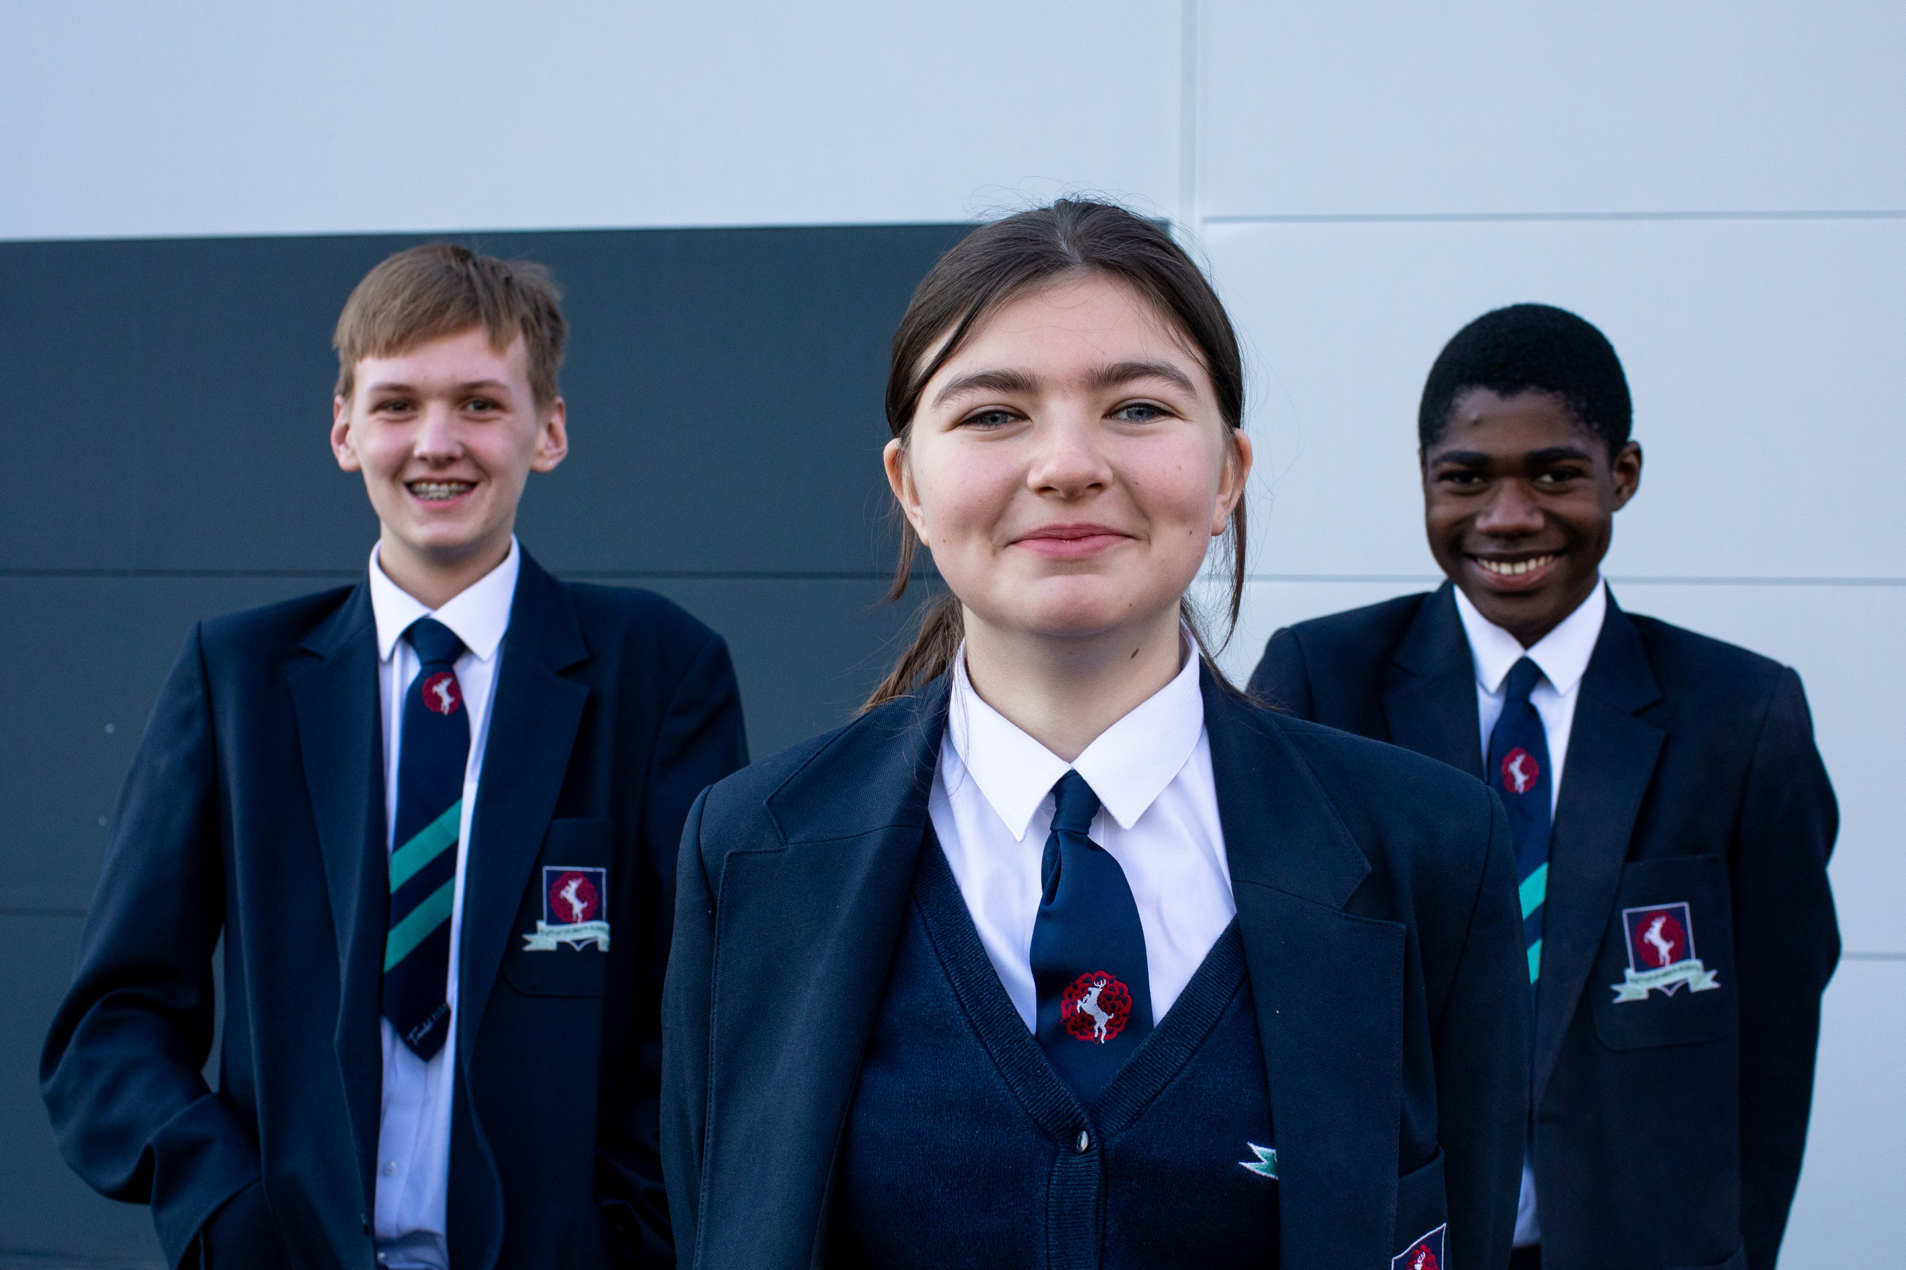
What are we going to be doing?
[Schools to include planned activities – posters, lessons, etc.]

Slide 7
Get involved!
Just Talk want as many young people engaging with the ‘Real Bodies in Herts’ campaign as possible.
Make sure you visit www.justtalkherts.org/realbodies to access any of the free resources available
Follow @JustTalkHerts on Instagram and make sure to give our posts a like/comment.
Speak to your teachers if you are interested in setting up a body image group in your school.

Slide 8
Thank you!

